Slide 1
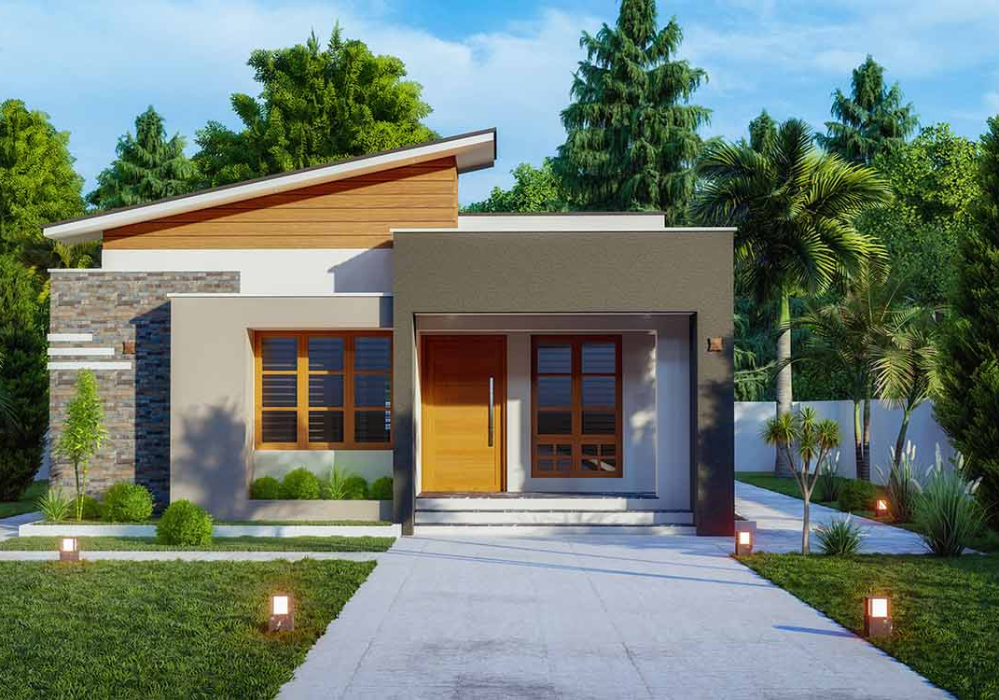

Home Ownership
The “American Dream”

Slide 2
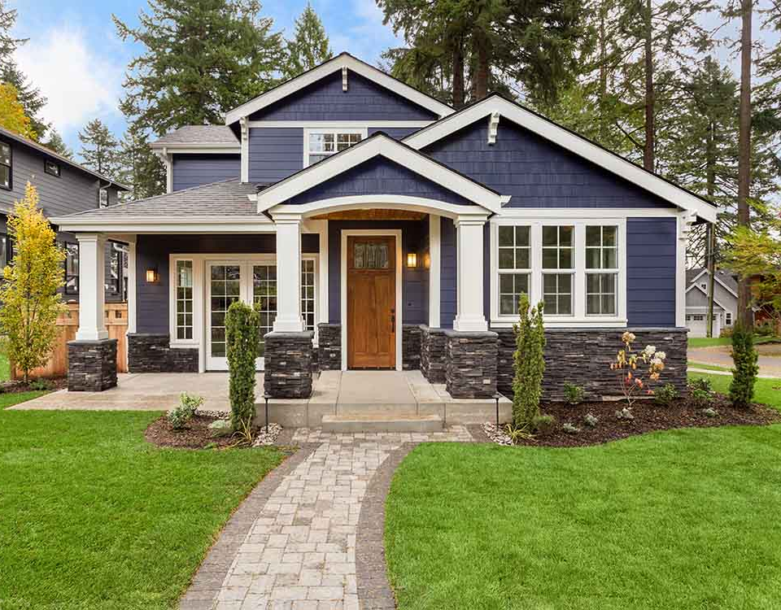
Home Ownership
The culmination of the “American Dream”
More than a place of shelter
Symbol of financial security and stability
The foundation for our families
Where treasured memories are made
Buying a home is a significent milestone in your life

Slide 3
Choose Your Realtor
Ask for client references and contact them
Request a CMA for listed homes
Comparative Market Analysis
Assess knowledge of neighborhoods
Evaluate understanding of market trends

Slide 4
MLS, PMI, CMA . . . Alphabet Soup?
CMA—Comparative Market Analysis
MLS—Multiple Listing Service
PMI—Private Mortgage Insurance
Avoid this cost with an 20% down payment

Slide 5
Types of Homes
Condo
Town home
Apartment
Duplex
Single-family home
Balance your current needs with long-term goals

Slide 6


Inflation and Sale Prices
Source: https://www.census.gov/construction/nrs/historical_data/index.html

Slide 7
Location, Location, Location
Work with your realtor
Search MLS (Multiple Listing Service)
Research online
Unbiased results with sites such as Trulia.com or Realtor.com
Interir and exterior photos, virtual online tours, descriptions
Private listing sites such as ForSaleByOwner.com or Craigslist.org
Visit homes that interest you
Make notes on good and bad qualities
Take lots of photos

Slide 8

The Buying Process
Get Professional Help
Choose your realtor
Address Financial Issues
Determine what you can afford for total housing expenses
Shop for a loan
Get preapproved
Shop for a Home
Determine needs versus wants
Research online
Visit actual homes
Close the Deal
Make an offer and negotiate as necessary
Get a home inspection
Get homeowner’s insurance

Slide 9

Strengthen Your Offer
Pre-Qualified
Pre-Approved
You provide your debt and credit information for your lender
Lender estimates what you can afford
You provide your debt and credit information for your lender
Lender examins your credit report
Checks debt-to-income ratio
Analyses your financial situation in more depth
A pre-approved offer is more likely to result in a completed sale.

Slide 10


Slide 11

Moving Day

Slide 12

7100 Madrone Road Roseville, CA 95722 916.460.3300

